Slide 1
MUSCLES OF THE HEAD

Slide 2
1. MUSCLES OF FACIAL EXPRESSION
The muscles of facial expression are located in the subcutaneous tissue, originating from bone or fascia, and inserting onto the skin. By contracting, the muscles pull on the skin and exert their effects. They are the only group of muscles that insert into skin.
These muscles have a common embryonic origin – the 2nd pharyngeal arch. They migrate from the arch, taking their nerve supply with them. As such, all the muscles of facial expression are innervated by the facial nerve.
The facial muscles can broadly be split into three groups: orbital, nasal and oral.

Slide 3
ORBITAL GROUP
The orbital group of facial muscles contains two muscles associated with the eye socket.
These muscles control the movements of the eyelids, important in protecting the cornea from damage.
They are both innervated by the facial nerve.

Slide 4
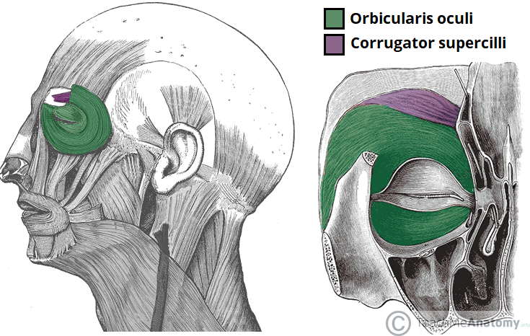

Slide 5
The orbicularis oculi muscle surrounds the eye socket and extends into the eyelid. It has three distinct parts – palpebral, lacrimal, and orbital.
Attachments – Originates from the medial orbital margin, the medial palpebral ligament, and the lacrimal bone. It then inserts into the skin around the margin of the orbit, and the superior and inferior tarsal plates.
Actions:
Palpebral part – gently closes the eyelids.
Lacrimal part – involved in the drainage of tears.
Orbital part – tightly closes the eyelids.
Innervation – Facial nerve (CN VII, temporal and zygomatic branches)

Slide 6
The corrugator supercilii is a much smaller muscle and is located posteriorly to the orbicularis oculi.
Attachments – Originates from the superciliary arch, running in a superolateral direction. Inserts into the skin of the eyebrow.
Actions – Acts to draw the eyebrows together, creating vertical wrinkles on the bridge of the nose.
Innervation – Facial nerve.

Slide 7
NASAL GROUP
The nasal group of facial muscles are associated with movements of the nose, and the skin around it.
There are three muscles in this group, and they are all innervated by the facial nerve.
They serve little importance in humans.

Slide 8
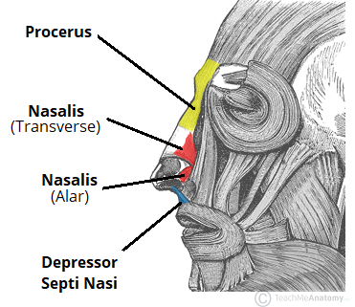

Slide 9
The nasalis is the largest of the nasal muscles. It is split into two parts: transverse and alar.
Attachments: Both portions of the muscle originate from the maxilla. The transverse part attaches to an aponeurosis across the dorsum of the nose. The alar portion of the muscle attaches to the alar cartilage of the nasal skeleton.
Actions: The two parts have opposing functions. The transverse part compresses the nares, and the alar part opens the nares.
Innervation: Facial nerve.

Slide 10
The procerus is the most superior of the nasal muscles. It also lies superficially to the other muscles of facial expression.
Attachments: It originates from the nasal bone, inserting into the lower medial forehead.
Actions: Contraction of this muscle pulls the eyebrows downward to produce transverse wrinkles over the nose.
Innervation: Facial nerve.

Slide 11
Depressor Septi Nasi
This muscle assists the alar part of the nasali in opening the nostrils.
Attachments: It runs from the maxilla (above the medial incisor tooth) to the nasal septum.
Actions: It pulls the nose inferiorly, opening the nares.
Innervation: Facial nerve.

Slide 12
ORAL GROUP
These are the most important group of the facial expressors: responsible for movements of the mouth and lips.
Such movements are required in singing and whistling and add emphasis to vocal communication.
The oral group of muscles consists of the orbicularis oris, buccinator, and various smaller muscles.

Slide 13
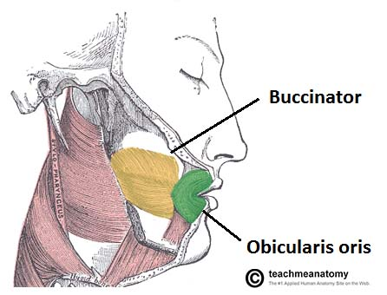

Slide 14
Orbicularis Oris
The fibres of the orbicularis oris enclose the opening to the oral cavity.
Attachments: Arises from the maxilla and from the other muscles of the cheek. It inserts into the skin and mucous membranes of the lips.
Action: Purses the lips.
Innervation: Facial nerve.

Slide 15
Buccinator
This muscle is located between the mandible and maxilla, deep to the other muscles of the face.
Attachments: It originates from the maxilla and mandible. The fibres run in an inferomedial direction, blending with the orbicularis oris and the skin of the lips.
Actions: The buccinator pulls the cheek inwards against the teeth, preventing accumulation of food in that area.
Innervation: Facial nerve.

Slide 16
There are other muscles that act on the lips and mouth. Anatomically, they can be divided into upper and lower groups:
The lower group contains the depressor anguli oris, depressor labii inferioris and the mentalis.
The upper group contains the risorius, zygomaticus major, zygomaticus minor, levator labii superioris, levator labii superioris alaeque nasi and levator anguli oris.

Slide 17
FACIAL NERVE PARALYSIS
DISCUSS INSTANCES WHERE FACIAL NERVE PARALYSIS CAN OCCUR
LIST 10 SIGNS OF FACIAL PARALYSIS
LIST 10 WAYS IN WHICH YOU CAN CLINICALLY TEST FOR DYSFUNCTION OF THE FACIAL NERVE

Slide 18
2. MUSCLES OF MASTICATION
The muscles of mastication are associated with movements of the jaw (temporomandibular joint).
There are four muscles:
Masseter
Temporalis
Medial pterygoid
Lateral pterygoid
The muscles of mastication develop from the first pharyngeal arch. Thus, they are innervated by a branch of the trigeminal nerve (CN V), the mandibular nerve.

Slide 19
The masseter muscle is the most powerful muscle of mastication. It is quadrangular in shape and has two parts: deep and superficial.
The entirety of the muscle lies superficially to the pterygoids and temporalis, covering them.
Attachments: The superficial part originates from maxillary process of the zygomatic bone. The deep part originates from the zygomatic arch of the temporal bone. Both parts attach to the ramus of the mandible.
Actions: Elevates the mandible, closing the mouth.
Innervation: Mandibular nerve (V3).

Slide 20
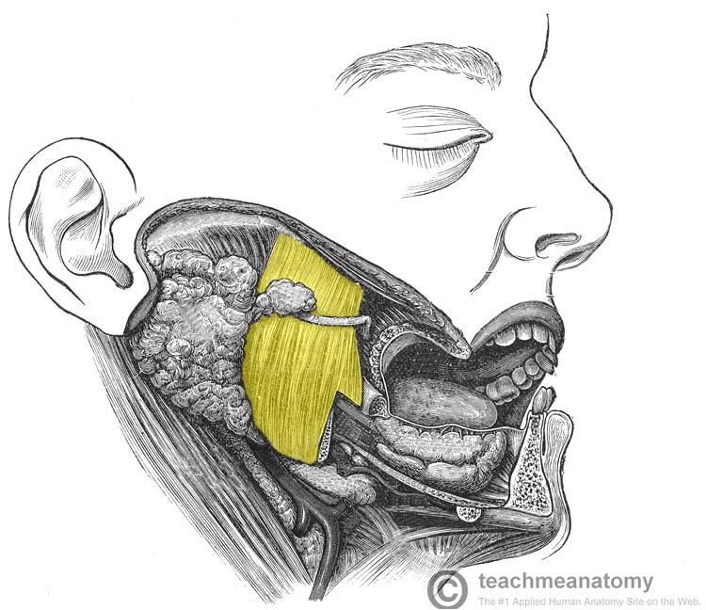

Slide 21
The temporalis muscle originates from the temporal fossa – a shallow depression on the lateral aspect of the skull. The muscle is covered by tough fascia which can be harvested surgically and used to repair a perforated tympanic membrane (an operation known as a myringoplasty).
Attachments: Originates from the temporal fossa. It condenses into a tendon, which inserts onto the coronoid process of the mandible.
Actions: Elevates the mandible, closing the mouth. Also retracts the mandible, pulling the jaw posteriorly.
Innervation: Mandibular nerve (V3).

Slide 22
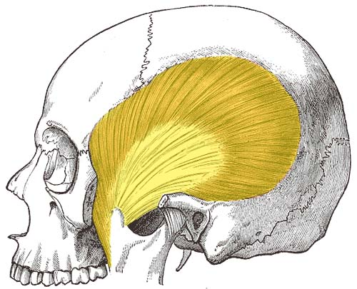

Slide 23
The medial pterygoid muscle has a quadrangular shape with two heads: deep and superficial. It is located inferiorly to the lateral pterygoid.
Attachments:
The superficial head originates from the maxillary tuberosity and the pyramidal process of palatine bone.
The deep head originates from the medial aspect of the lateral pterygoid plate of the sphenoid bone.
Both heads attach to the ramus of the mandible near the angle of mandible.
Actions: Elevates the mandible, closing the mouth.
Innervation: Mandibular nerve (V3).

Slide 24
The lateral pterygoid muscle has a triangular shape with two heads: superior and inferior. It has horizontally orientated muscle fibres, and thus is the major protractor of the mandible.
Attachments:
The superior head originates from the greater wing of the sphenoid.
The inferior head originates from the lateral pterygoid plate of the sphenoid.
The two heads converge into a tendon which attaches to the neck of the mandible.
Actions: Acting bilaterally, the lateral pterygoids protract the mandible, pushing the jaw forwards. Unilateral action produces the ‘side to side’ movement of the jaw.
Note: Contraction of the lateral pterygoid will produce lateral movement on the contralateral side. For example, contraction of left lateral pterygoid will deviate the mandible to the right.
Innervation: Mandibular nerve (V3).

Slide 25
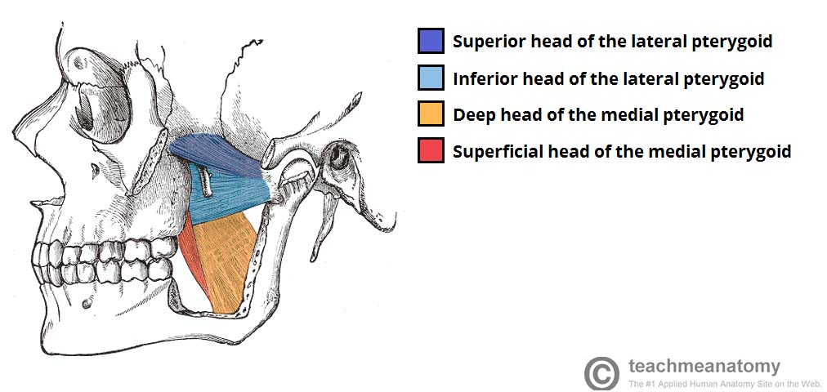

Slide 26
3. MUSCLES OF THE TONGUE
THE TONGUE

Slide 27
EMBRYOLOGY
first branchial arch is supplied by the trigeminal nerve, the second by the facial, the third by the glossopharyngeal, and the fourth and sixth by the vagus.
When the tongue is developing, it starts as a two longitudinal bulbous ridges, with contribution from the first four branchial arches.
These ridges join, giving rise to the longitudinal line (median sulcus) down the centre of the tongue.
The contribution from the second branchial arch is grown over by that of the third arch, but the nerve supply remains.
This is why the majority of the tongue’s innervation is by the trigeminal nerve (CN V) and the glossopharyngeal nerve CN IX.

Slide 28
At the back of the tongue – there is a transverse line near the root of the tongue. This is called sulcus terminalis, and in the centre, where it meets the median sulcus, there is a pit.
This is the closed top of a deep pit, the foramen cecum (blind window), at the end of which lies the thyroid gland.
During development, this descends from the tongue down into the neck, If, on the way down, the pit (thyroglossal duct) doesn’t close behind the gland, midline thyroglossal cysts or fistulae may remain.

Slide 29
INTRINSIC MUSCLES OF THE TONGUE
The intrinsic muscles only attach to other structures in the tongue. There are four paired intrinsic muscles of the tongue and they are named by the direction in which they travel: the superior longitudinal, inferior longitudinal, transverse and vertical muscles of the tongue.
These muscles affect the shape and size of the tongue – for example, in tongue rolling – and have a role in facilitating speech, eating and swallowing.
Motor innervation for the intrinsic muscles of the tongue is via the hypoglossal nerve (CNXII).

Slide 30
EXTRINSIC MUSCLES OF THE TONGUE
Genioglossus
Attachments: Arises from the mandibular symphsis. Inserts into the body of the hyoid bone and the entire length of the tongue.
Function: Inferior fibres protrude the tongue, middle fibres depress the tongue, and superior fibres draw the tip back and down
Innervation: Motor innervation via the hypoglossal nerve (CNXII).

Slide 31
Hyoglossus
Attachments: Arises from the hyoid bone and inserts into the side of the tongue
Function: Depresses and retracts the tongue
Innervation: Motor innervation via the hypoglossal nerve (CNXII).

Slide 32
Styloglossus
Attachments: Originates at the styloid process of the temporal bone and inserts into the side of the tongue
Function: Retracts and elevates the tongue
Innervation: Motor innervation via the hypoglossal nerve (CNXII).

Slide 33
Palatoglossus
Attachments: Arises from the palatine aponeurosis and inserts broadly across the tongue
Function: Elevates the posterior aspect of the tongue
Innervation: Motor innervation via the vagus nerve (CNX).
All of the intrinsic and extrinsic muscles are innervated by the hypoglossal nerve (CN XII), except palatoglossus, which has vagal innervation (CN X).

Slide 34
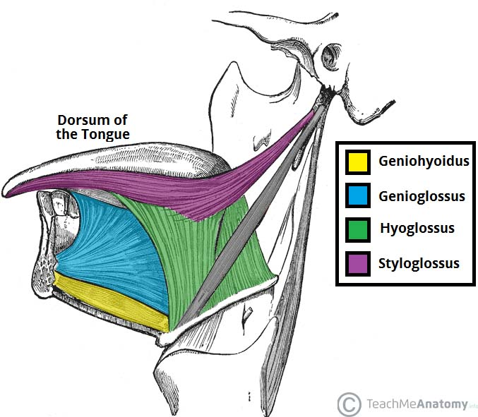

Slide 35
NERVE SUPPLY TO THE TONGUE
In the anterior 2/3, general sensation is supplied by the trigeminal nerve (CNV). Specifically the lingual nerve, a branch of the mandibular nerve (CN V3).
On the other hand, taste in the anterior 2/3 is supplied from the facial nerve (CNVII). In the petrous part of the temporal bone, the facial nerve gives off three branches, one of which is chorda tympani. This travels through the middle ear, and continues on to the tongue.
The posterior 1/3 of the tongue, Both touch and taste are supplied by the glossopharyngeal nerve (CNIX).

Slide 36
BLOOD SUPPLY
The lingual artery (branch of the external carotid) does most of the supply, but there is a branch from the facial artery; the tonsillar artery, which can provide some collateral circulation.
Drainage is by the lingual vein.

Slide 37
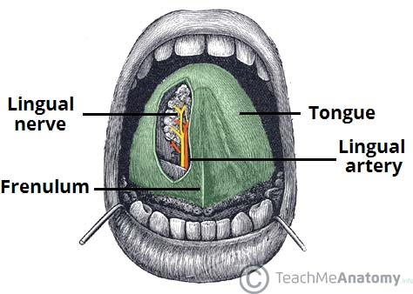

Slide 38
The lymphatic drainage of the tongue is as follows:
Anterior two thirds – initially into the submental and submandibular nodes, which empty into the deep cervical lymph nodes
Posterior third – directly into the deep cervical lymph nodes

Slide 40
TONGUE TIE
The tongue is attached anteroinferiorly by a piece of connective tissue called the frenulum, which lies in the midline.
The process by which the frenulum is formed is the same by which the fingers form, and is known as sculpting apoptosis.
if this process fails, it can result in excess frenulum. This is called a tongue-tie, and presents in children.
There are varying degrees of severity of tongue-tie and in some cases it can restrict the movement of the tongue causing difficulties with breast feeding. This can be managed with simple surgery.

Slide 41
